Slide 1

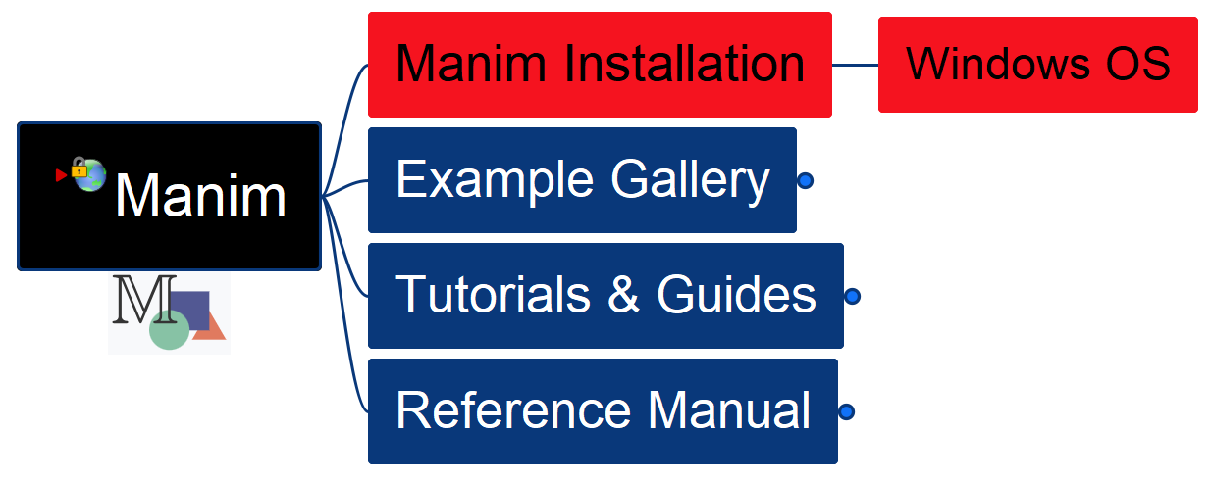

Learn Manim Library by Practice – Opening and Installation
001

Slide 2
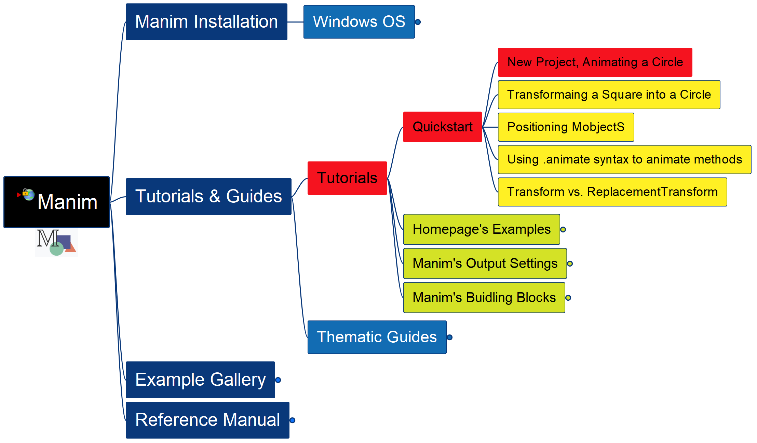
Learning Manim
002
Tutorial – QuickStart – New Project

Slide 3
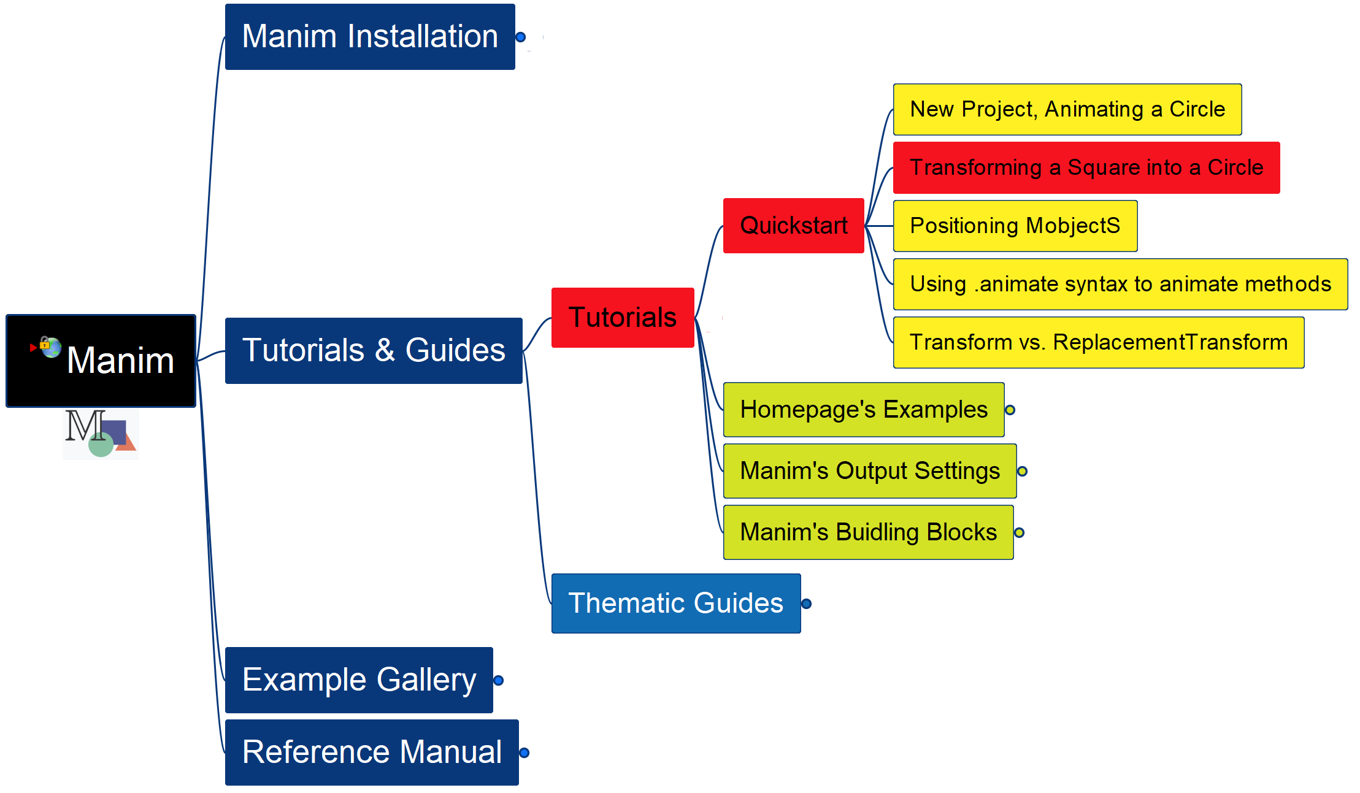
Learning Manim
003
Transform a Square into a Circle

Slide 4
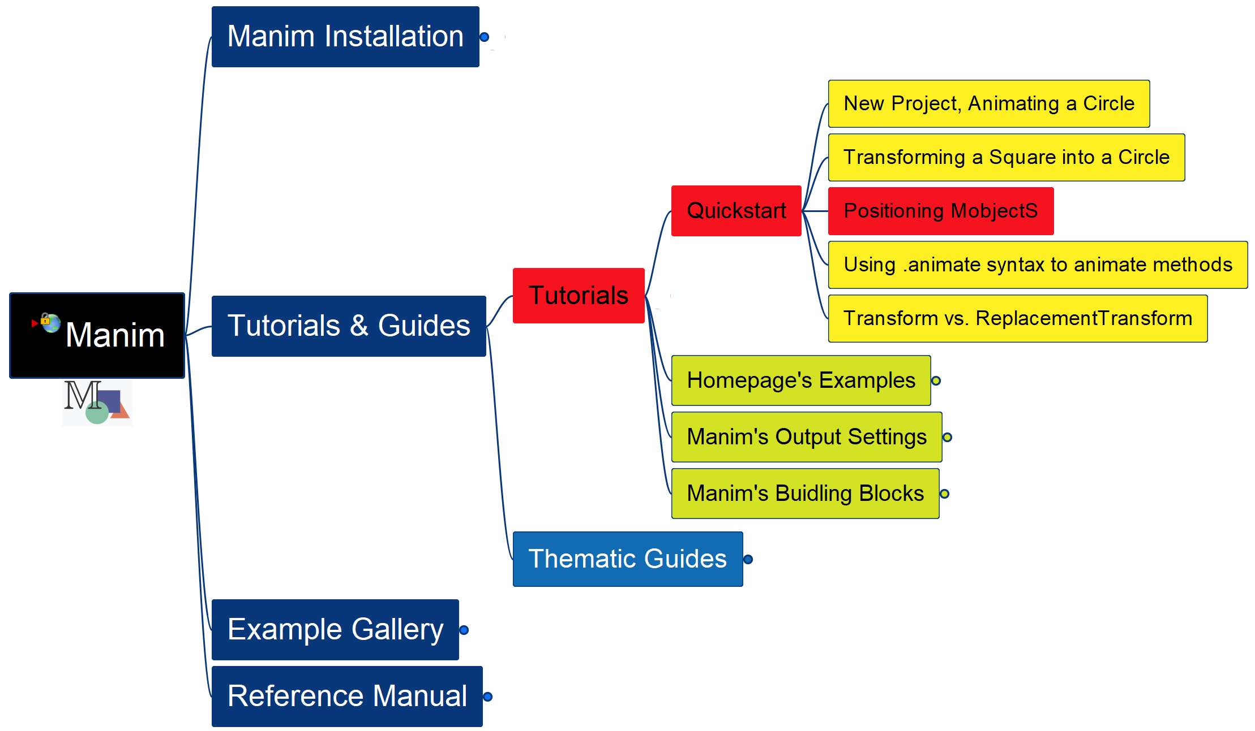
Learning Manim
004
Positioning MobjectS

Slide 5
Learning Manim
005
Using .animate syntax

